Slide 1
Attention Is All You Need
Easy English Presentation
Based on the Transformer paper by Vaswani et al. (NIPS 2017)
Presentation goal: explain the paper simply enough to present in class.
Main idea: use attention, not RNNs or CNNs
Result: faster training + better translation
Attention Is All You Need | Easy Presentation
01
Notes:
Start by saying: This presentation explains the famous Transformer paper in simple English. The key message is that attention can replace recurrent and convolutional layers for sequence-to-sequence tasks like translation.

Slide 2
Roadmap
What this presentation will cover
1
The problem before Transformer
2
The big idea of attention-only models
3
Encoder, decoder, and attention
4
Training setup and results
5
Final takeaways and viva points
Attention Is All You Need | Easy Presentation
02
Notes:
Give the audience a quick plan. Do not spend long here. Say that the deck starts from the basic problem and slowly builds toward the Transformer architecture.

Slide 3
Paper in One Minute
The simple summary before going into details
The Transformer is a neural network architecture for sequence-to-sequence tasks.
Before Transformer
Transformer
• RNNs read tokens one by one.
• CNNs use local windows and many layers.
• Long-distance relationships are harder to learn.
• Uses self-attention as the main operation.
• Looks at all tokens directly.
• Runs more in parallel, so training is faster.
In short: the model learns which words should pay attention to which other words.
Attention Is All You Need | Easy Presentation
03
Notes:
Say: The paper proposes the Transformer. It is not using RNNs or CNNs as the main sequence model. It uses attention to connect words directly.

Slide 4
Problem Before Transformer
Why RNN-based models were slow and limited
RNN / LSTM
Main limitation
Reads tokens one by one
Sequential computation
• Step 2 depends on step 1.
• Step 3 depends on step 2.
• GPU cannot fully process all positions at once.
I
love
AI
• Hard to parallelize inside one sentence.
• Long sentences create long information paths.
• Training becomes slow for large data.
Transformer solves this by letting every token directly compare with every other token.
Attention Is All You Need | Easy Presentation
04
Notes:
Explain the RNN issue simply: it reads like a person reading one word after another. That makes it slow because later words wait for earlier words.

Slide 5
Core Idea: Attention Only
No recurrence. No convolution. Attention becomes the main engine.
Instead of passing memory step-by-step, every token asks:
“Which other tokens are important for understanding me?”
The
animal
did
not
cross
the
street
because
it
was
tired
Attention can connect “it” to “animal” directly.
• Good for long-distance relationships in a sentence.
• Good for parallel processing on GPUs.
• Attention weights can be visualized, so the model is easier to inspect.
Attention Is All You Need | Easy Presentation
05
Notes:
Use the example with “it” and “animal”. Attention helps the model connect related words even when they are far apart.

Slide 6
Sequence-to-Sequence Basics
Transformer was designed for tasks like machine translation
Input sentence
Encoder
Decoder
Output sentence
Example
English: “I love machine learning.”
German: “Ich liebe maschinelles Lernen.”
• Encoder understands the input sequence.
• Decoder generates the output sequence token by token.
• Attention helps the decoder focus on the right input words.
Attention Is All You Need | Easy Presentation
06
Notes:
Define seq-to-seq: one sequence goes in and another sequence comes out. Translation is the main example used in the paper.

Slide 7
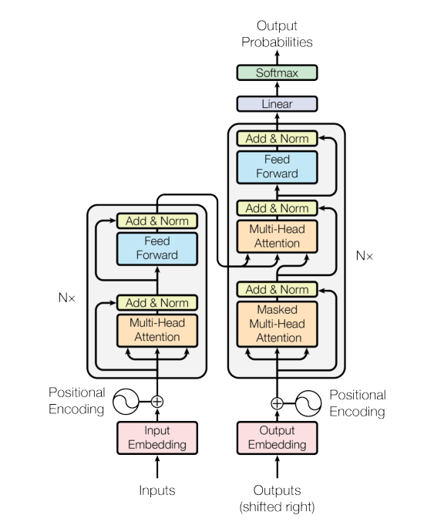
Transformer Architecture
Original diagram: encoder on the left, decoder on the right
How to read it
• Bottom: tokens become embeddings.
• Positional encoding adds word-order information.
• Encoder and decoder are repeated N = 6 times.
• Self-attention finds relationships between tokens.
• Feed-forward layers transform the information.
• Softmax gives probabilities for the next output token.
Easy mental model: input words go through attention blocks, then the decoder writes the translated sentence.
Source figure: Vaswani et al. (2017)
Attention Is All You Need | Easy Presentation
07
Notes:
Tell them the diagram has two towers. The left tower understands the input. The right tower generates the output. Each tower repeats similar layers.

Slide 8
Encoder Stack
The encoder builds a rich representation of the input sentence
Encoded
Representations
What each part does
Feed Forward
Network
• Self-attention: each input token looks at all input tokens.
• Feed-forward network: processes each token representation separately.
• Add & Norm: stabilizes training and keeps useful previous information.
• Output: one vector for every input token.
Add & Norm
Repeated 6
times
Multi-Head
Self-Attention
Input Embedding
+ Position
Attention Is All You Need | Easy Presentation
08
Notes:
Explain encoder as the reading part. It reads the whole input sentence and creates useful vectors. In the encoder, attention is self-attention because Q, K, and V all come from the input side.

Slide 9
Decoder Stack
The decoder generates the output sentence step by step
Next Token
Probability
Important idea: masking
Feed Forward
• During training, the decoder should not see future words.
• A mask blocks attention to future positions.
• This keeps generation fair: token i only depends on earlier tokens.
• Then softmax chooses the next token probability.
Encoder-Decoder
Attention
Encoder Output
Masked
Self-Attention
Previous Output
Tokens
Example: while predicting word 4, the model cannot look at word 5.
Attention Is All You Need | Easy Presentation
09
Notes:
Explain decoder as the writing part. It writes output one token at a time. Masking prevents cheating by hiding future output tokens.

Slide 10
Attention Intuition: Q, K, V
Attention is like searching for the most useful information
Query (Q)
Key (K)
Value (V)
What am I looking for?
What information do I contain?
What information will I give?
Easy example:
A word asks a question (Q), compares it with all labels (K), then collects useful answers (V) as a weighted sum.
Higher similarity between Q and K means higher attention weight.
Attention Is All You Need | Easy Presentation
10
Notes:
Q means query, K means key, V means value. The model compares queries with keys to decide how much of each value to use.

Slide 11
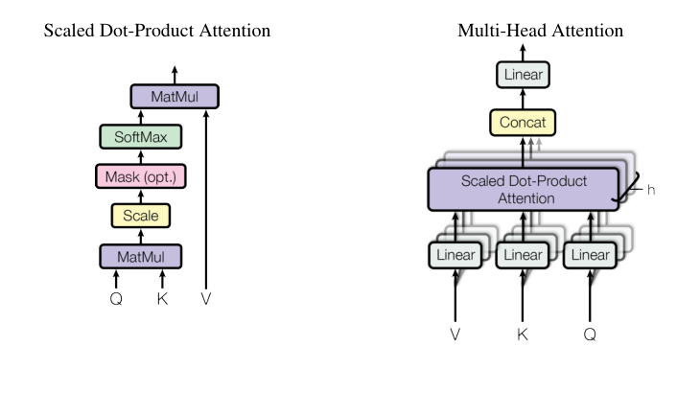
Scaled Dot-Product Attention
The main attention formula used in the paper
Formula
Attention(Q, K, V) = softmax(QKᵀ / √dₖ) V
1. Compare Q with K using dot product.
2. Scale by √dₖ to keep numbers stable.
3. Apply softmax to get attention weights.
4. Multiply weights with V to get the output.
Source figure: Vaswani et al. (2017)
Why scale? Without scaling, softmax can become too sharp and gradients can become tiny.
Attention Is All You Need | Easy Presentation
11
Notes:
Do not overcomplicate the formula. Say it in four steps: compare, scale, softmax, combine. The scaling keeps training stable.

Slide 12
Multi-Head Attention
Many attention heads learn different relationships at the same time
One attention head is one viewpoint.
Paper setting
Multiple heads = multiple viewpoints in parallel.
• Base model uses 8 heads.
• Each head uses smaller dimensions.
• Total cost stays similar to one large attention head.
Head 1
Head 2
Head 3
Head 4
word meaning
grammar
long link
position
Concatenate
+ Linear
Attention Is All You Need | Easy Presentation
12
Notes:
Give analogy: one person may focus on meaning, another on grammar, another on long-distance links. Multi-head attention lets the model learn several relationships simultaneously.

Slide 13
Positional Encoding
Attention alone does not know word order, so position is added
Problem:
Self-attention sees all tokens together, so it needs extra information about order.
Word embedding
+
Positional encoding
=
Input to Transformer
• The paper uses sine and cosine functions of different frequencies.
• This gives each token position a unique pattern.
• The model can learn relative positions such as “next word” or “two words before”.
Easy line: positional encoding tells the model where each word is located.
Attention Is All You Need | Easy Presentation
13
Notes:
Explain that RNNs naturally know order because they read step by step. Transformer processes tokens in parallel, so it adds positional encoding to represent order.

Slide 14
Why Self-Attention Works Well
Three advantages compared with RNN/CNN sequence models
1
Parallel training
2
Short path length
3
Interpretability
All positions can be processed together, so training is faster.
Any word can directly connect to any other word in one attention layer.
Attention maps can show which words the model focuses on.
The paper also compares complexity and path length to recurrent and convolutional layers.
Attention Is All You Need | Easy Presentation
14
Notes:
Keep this slide simple. Self-attention is powerful because it is parallel, it connects distant tokens quickly, and attention maps can be inspected.

Slide 15
Training Setup
How the authors trained the Transformer
Data
Training
• WMT 2014 English-German: about 4.5M sentence pairs.
• WMT 2014 English-French: about 36M sentence pairs.
• Subword tokenization was used to handle rare words.
• Trained on 8 NVIDIA P100 GPUs.
• Base model: 100,000 steps, about 12 hours.
• Big model: 300,000 steps, about 3.5 days.
• Used Adam optimizer, dropout, and label smoothing.
Important: the paper shows strong results with much lower training cost than many previous models.
Attention Is All You Need | Easy Presentation
15
Notes:
Mention that the training section is not the main theory. The key facts are the datasets, GPUs, training time, and regularization methods.

Slide 16
Results
Transformer achieved strong translation performance
Model
EN-DE BLEU
EN-FR BLEU
Simple meaning
Transformer base
27.3
38.1
Strong even with lower cost
Transformer big
28.4
41.8
Best results reported in the paper
Previous strong models
≈24–26
≈39–41
Usually slower or costlier
• BLEU is an automatic metric for machine translation quality.
• Higher BLEU means the translation is closer to reference translations.
• The big Transformer outperformed earlier models on English-German and English-French translation.
Data summarized from Table 2 of the paper.
Attention Is All You Need | Easy Presentation
16
Notes:
Explain BLEU very simply. Say the Transformer big got 28.4 on English-German and 41.8 on English-French, which was very strong at that time.

Slide 17
Common Viva Questions
Short answers you can say in presentation or Q&A
Q1: Why is the paper called “Attention Is All You Need”?
Because the model replaces recurrence and convolution with attention mechanisms.
Q2: What is self-attention?
A token attends to other tokens in the same sequence to build its representation.
Q3: Why use multi-head attention?
Different heads can learn different relationships at different positions.
Q4: Why positional encoding?
The model needs position information because attention itself has no order.
Q5: What is the main achievement?
Faster training and better translation results than previous strong sequence models.
Attention Is All You Need | Easy Presentation
17
Notes:
Use these answers if the teacher asks questions. Keep answers short and confident.

Slide 18
Final Takeaways
Remember these five points
1. Transformer is an encoder-decoder model for sequence tasks.
2. It removes RNNs and CNNs from the main architecture.
3. Self-attention lets every token directly look at every other token.
4. Multi-head attention learns several relationships in parallel.
5. The paper achieved strong translation results with faster training.
One-line conclusion: attention made sequence modeling faster, more flexible, and very powerful.
Attention Is All You Need | Easy Presentation
18
Notes:
End with confidence. Repeat the one-line conclusion.

Slide 19
Reference
Source used for this presentation
Vaswani, A., Shazeer, N., Parmar, N., Uszkoreit, J., Jones, L., Gomez, A. N., Kaiser, L., & Polosukhin, I. (2017).
Attention Is All You Need. Advances in Neural Information Processing Systems (NIPS/NeurIPS).
• Figures in this deck are reproduced from the paper for scholarly presentation with attribution.
• Main paper ideas summarized in simple English for class presentation.
Thank you
Attention Is All You Need | Easy Presentation
19
Notes:
This is the final reference slide. Mention that all content is based on the original paper and figures have proper attribution.

